Slide 1

Waste Sorting
Omer, Nir, and shir present:

Slide 2
Quick Recap
The simulation sorts different kind of waste to recycling bins
We are using multiple robotic arms to sort the trash in parallel
Notes:
Go over things at POC:
Caught a single static trash and threw it to the bin.
Created the background environment.

Slide 3
Major Components
Arms
Motion planning
Parallel environment
Task managers

Slide 4
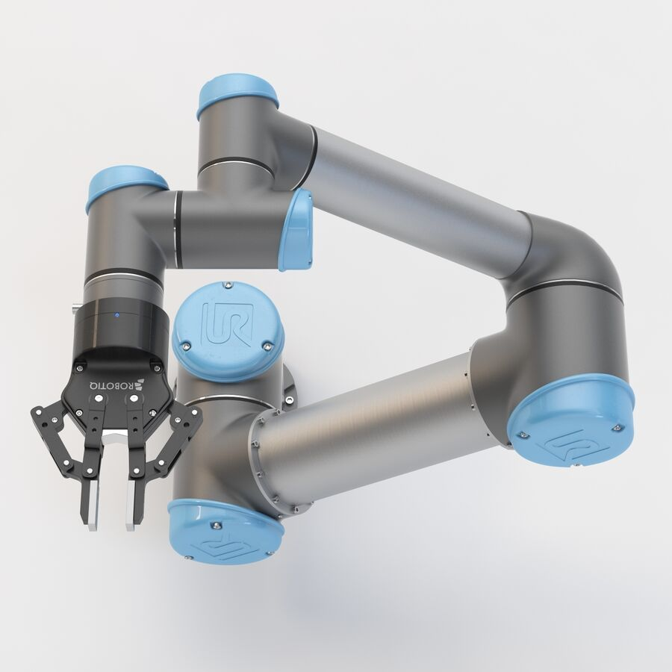
Arms
Arm operations are not atomic – use state machine for synchronous execution of multiple arms in an online manner
Notes:
Challenges:
1. Synchronization between the arms and the trash.
2. the BiRRT algorithm gets stuck in bad configurations when doing backwards movement.
Solutions:
1. The state machine, waiting for the trash to get to the gripper, ticks heuristics.
2. Giving BiRRT simpler paths, to avoid the problematic configurations.

Slide 5
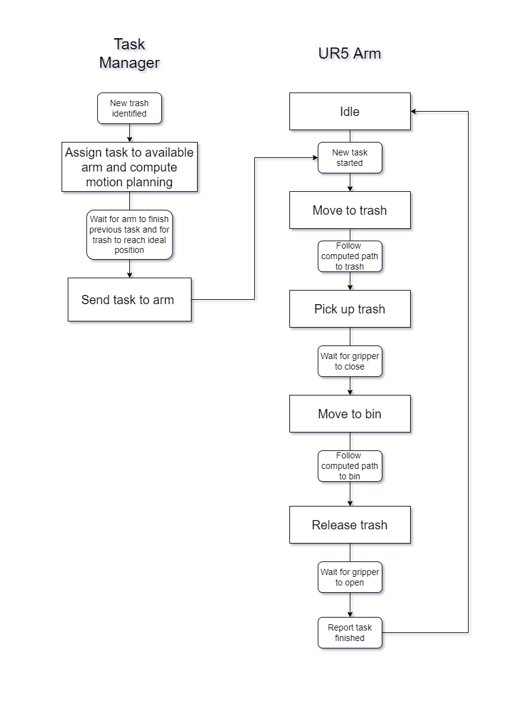
Notes:
Challenges:
1. Synchronization between the arms and the trash.
2. the BiRRT algorithm gets stuck in bad configurations when doing backwards movement.
Solutions:
1. The state machine, waiting for the trash to get to the gripper, ticks heuristics.
2. Giving BiRRT simpler paths, to avoid the problematic configurations.

Slide 6
Arms
Arm operations are not atomic – use state machine for synchronous execution of multiple arms in an online manner
Our BiRRT assumed no gripper
PyBullet restrictions make gripper collision difficult, workaround is used instead
Gripping objects is sensitive: arm movement, position and timing must be precise
Use heuristics initially and adjust when close to pickup
Notes:
Challenges:
1. Synchronization between the arms and the trash.
2. the BiRRT algorithm gets stuck in bad configurations when doing backwards movement.
Solutions:
1. The state machine, waiting for the trash to get to the gripper, ticks heuristics.
2. Giving BiRRT simpler paths, to avoid the problematic configurations.

Slide 7
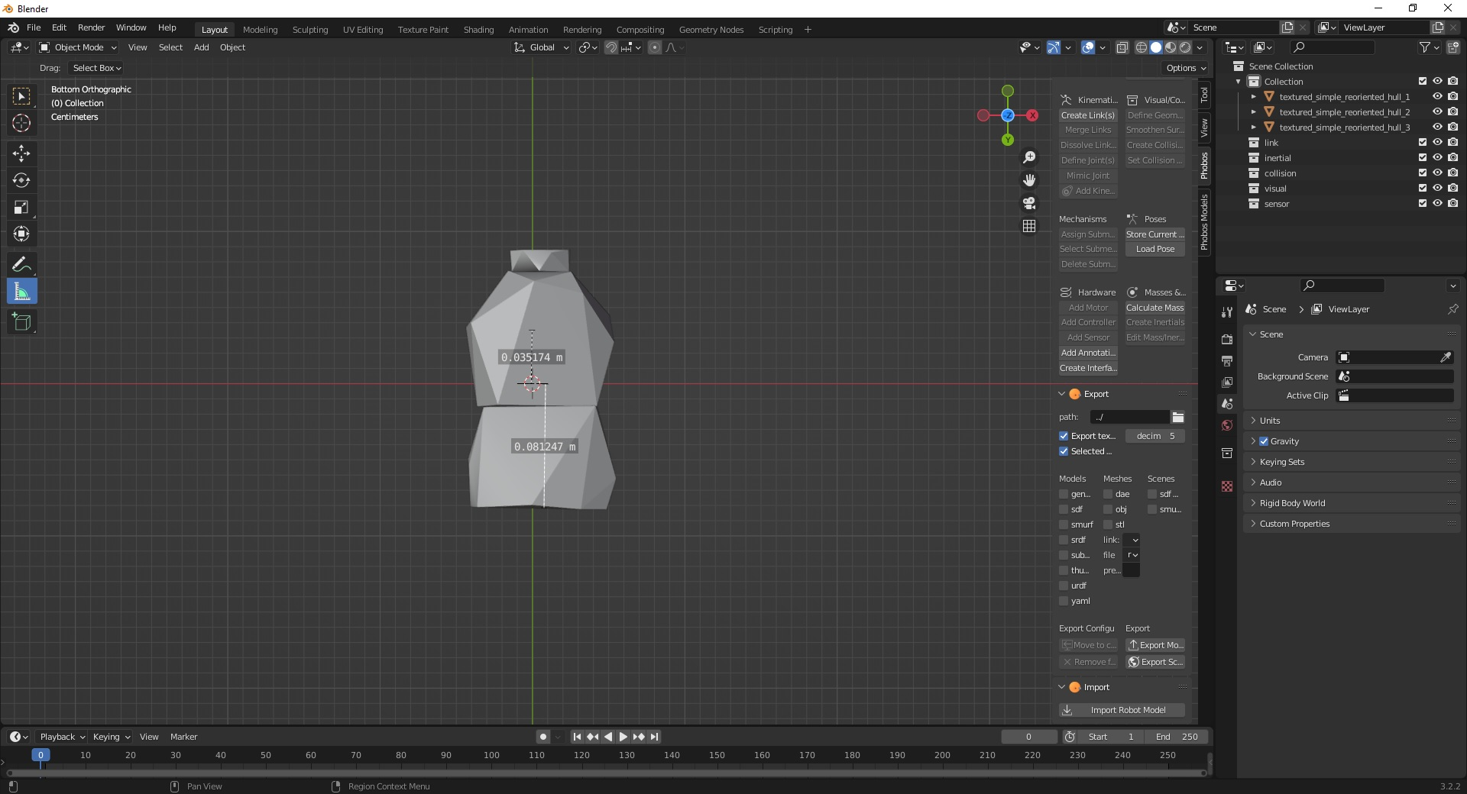
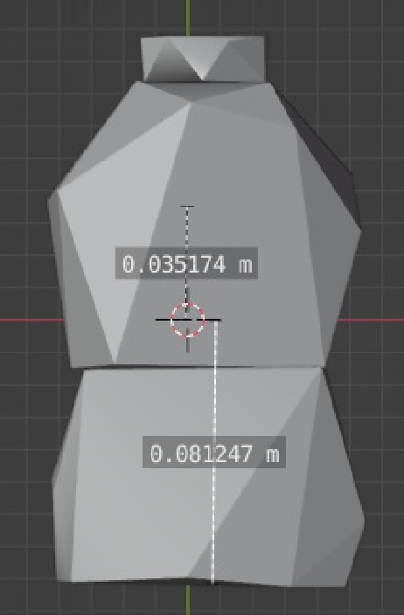
Notes:
Challenges:
1. Synchronization between the arms and the trash.
2. the BiRRT algorithm gets stuck in bad configurations when doing backwards movement.
Solutions:
1. The state machine, waiting for the trash to get to the gripper, ticks heuristics.
2. Giving BiRRT simpler paths, to avoid the problematic configurations.

Slide 8
Motion Planning
The motion plan calculations are done in a different environment than the simulation itself
This is to avoid collisions with the trash objects when sampling configurations for BiRRT
We now support throwing to the same trash bin as well
Trying to take the shortest path that will not result in a lot of computations
Notes:
Challenges:
Motion planning knocks trash objects over when sampling.
Motion planning might take *a lot* of time to run.
Minimize running time vs. maximizing path optimality.
Solutions:
Move the motion planning to a different environment.
Make the path simpler, so the motion planning would be a lot faster.
Calculate the optimal rotation angle between the arm and the bin.

Slide 9
Parallel Environment
The simulation gets stuck every time we do a motion planning calculation
Solution: Create a different process to do the calculation in
Requires communication between the main simulation process and the different worker processes
Notes:
Challenges:
The simulation takes a lot of time to do a single motion planning request (0.01-0.02 secs per iteration in BiRRT, usually 20-40 iterations).
We need a way to communicate between the main process and the worker processes.
We can’t share all the data between the processes (for example, we can’t send a UR5 object to a worker process).
The transition from synchronous code to parallel code.
Solutions:
Create a different background environment worker process per each UR5 arms pair.
The main process sends calculation requests to the worker process of the relevant arm pair and polls the worker processes for finished calculations.
Need to go over the code, and change the data needed for a motion planning to be only communication-safe objects (like python basic data types).

Slide 10
Task Manager
The task manager interface allows us to manage how tasks are dispatched to the different arms
There is a simple interface for a task manager component, which classes extend
We have developed increasingly complex task managers to support more capabilities to our simulation
Notes:
Challenges:
Need a way to easily change the task managers.
Hard to debug overly-complex task managers.
Solutions:
Create an interface for task managers.
Have each task manager add one single capability to make it easier to debug (SimpleTaskManager – basic, ParallelTaskManager – adds parallelism, AdvancedParallelTaskManager – adds throwing one trash, and smarter task management).

Slide 11
Future Work
Improve task manager efficiency
Object detection
Automatic learning of gripping point
Make motion planning more “online”

Slide 12
Live Simulation
Let’s run it!
Notes:
IMPORTANT: Tell the audience about the limitation of the simulation – memory hungry, and CPU hungry!!! Therefore, we can’t run it for a long time, and the performance might be sub-optimal.

Slide 13

Questions?

